Slide 1
Understanding Algorithms in Machine Learning
Sikander Randhawa

Slide 2
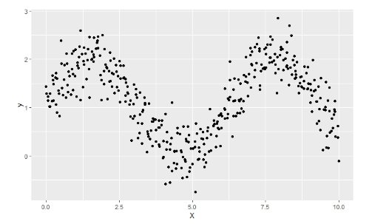

Machine learning in a nutshell.
(extremely oversimplified)
Output a rule which assigns unlabelled, unseen data to a label.
Use the data to find the best or most likely way to assign labels to new data points.
Start with a bunch of data. Each entry comes with features and a label.

Slide 3
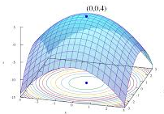
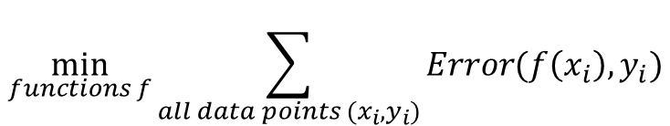
What’s going on in the black box?
Usually this means we are solving an optimization problem…
Use the data to find the best or most likely way to assign labels to new data points.
The problem often involves a term for each datapoint (like least squares)
$$\min_{functions f}{\sum_{all data points (x_{i},y_{i})}{Error(f\left(x_{i}\right),y_{i})}}$$

Slide 4
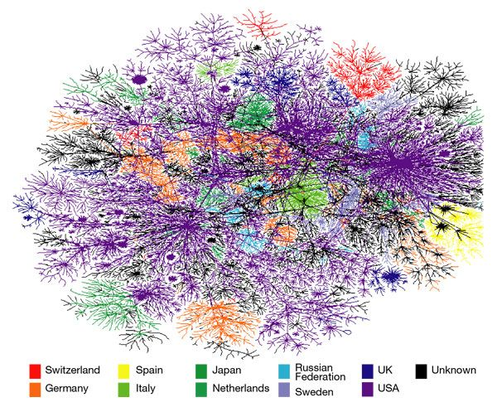


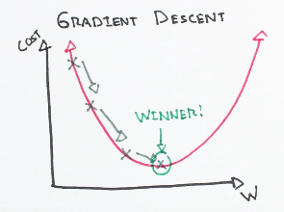
What is special about optimization problems for machine learning?
There can be millions of datapoints… Need algorithms that scale.
Often non convex/concave … i.e. the functions are not easy to work with.
Often we need to make decisions in real time … online machine learning.

Slide 5
What my research is focused on
Theoretical performance guarantees of usual algorithms used to solve optimization problems which appear in machine learning.
Example: Convergence rates of Stochastic Gradient Descent.
Designing theoretically optimal algorithms in settings which machine learning practitioners often find themselves in.
Example: Optimal online machine learning algorithms – (no regret learning).

Slide 6
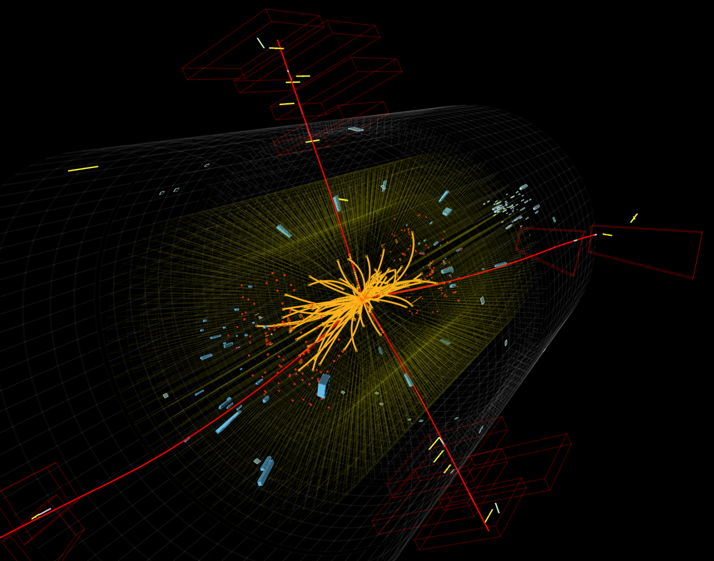

Why is theory important?
The Higgs boson. It’s theoretical existence was proposed in 1964 by Peter Higgs and 5 other physicists.
The boson’s existence was confirmed in 2012 based on collisions at the Large Hadron Collider.

Slide 7


Why is theory important?
On September 14, 2015, wen LIGO physically felt the distortions in spacetime caused by passing gravitational waves generated by two colliding black holes nearly 1.3 billion light years away.
Albert Einstein predicted the existence of gravitational waves in 1916 in his general theory of relativity

Slide 8
Why is theory important?
Research in Machine Learning feels different. Empirical results have raced far ahead of our theoretical understanding of the field.
Running experiments in machine learning is a relatively low cost endeavour – compared to building the Large Hadron Collider!
Perhaps a deeper theoretical understanding of the field can lead to a more fruitful and directed search for better machine learning models in the future.

Slide 9

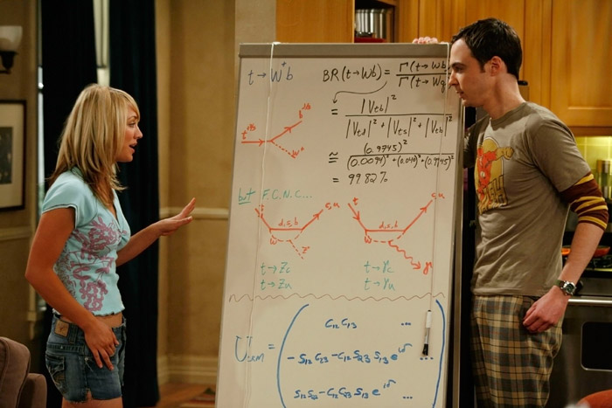
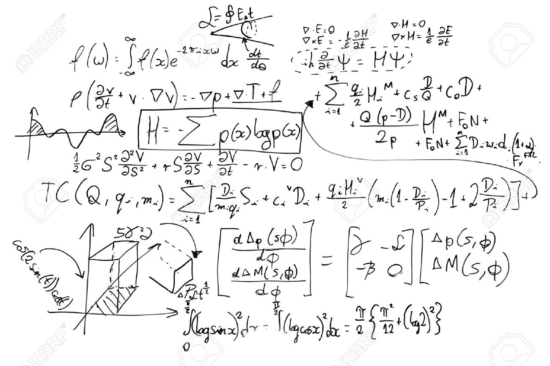
What theoretical research is like
Long periods of time in deep thought.
Stimulating brainstorming sessions with colleagues. (My favorite part!!)
Lots of math!

Slide 10
Why and how I got into research
I did a few co-op internships, and I felt like I wasn’t being pushed to my intellectual limits.
So, I quit – and signed up for a summer research position instead.
Note: This is not advisable. The co-op office was not happy about this …
I struggled mightily in my first research position.
But I was growing as a person. Research gave me the space I needed to challenge myself.

Slide 11
Pros and cons for research in theoretical machine learning
Pros
Challenging problems to work will expand your intellectual capabilities.
As opposed to research in pure mathematics, you don’t need to spend years learning background before you can contribute.
Unlimited supply of problems to work on.
Problems are motivated by the hottest field in Computer Science right now.
Cons
Your non CS friends think you spend your time “inventing formulas”…
When you tell people you are a grad student in CS, they assume you can code …
Often are unsure about if you are making progress for long periods of time.

